Slide 1

Craft Brewery Presentation
As Prepared By Team Uno Solutions, LLC
Afreen Siddiqui
Anthony Egbuniwe
Bruce Kimbark

Slide 2
Goals for this Presentation
You are interested in opening a craft brewery in the United States
We have been hired to identify:
The best locations to place a new brewery
Strong market opportunity
Consider existing competition against regional economic strength
Based upon current craft brewery landscape
The best products to offer
Most popular products on the market today
Opportunity to choose popular choices as a baseline while offering a chance to produce some uncommon options to create a market niche

Slide 3
Overview
This presentation we will touch upon the following topics:
A general overview of the craft beer industry
A brief discussion of our data gathering and analysis
Discussion of best opportunities for a new brewery
An analysis of the craft beer data
Discussion of the beer options available
Conclusion with our recommendations

Slide 4
Craft Beer Industry

Slide 5
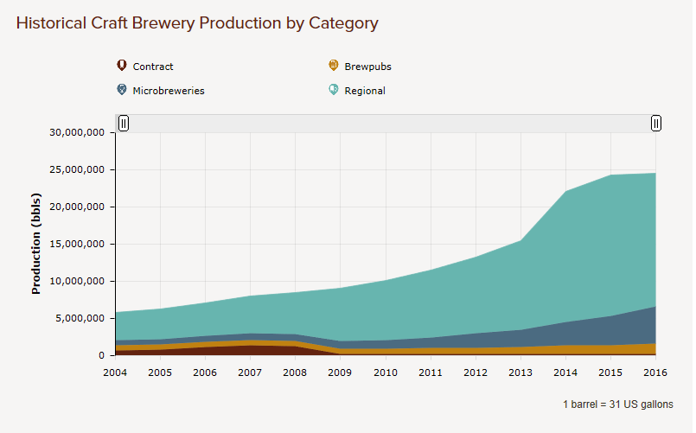
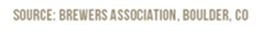
The Craft Beer Industry is Still Growing
After explosive growth the past few years, growth has slowed.
But there is still opportunity for a smart brewer.
Regional breweries make up approximately 71% of the craft beer industry
Microbreweries are gaining traction
Regional Brewery: A brewery that produces over 15,000 barrels and produces beer in a traditional or non-mechanized way
A regional brewery is the goal

Slide 6
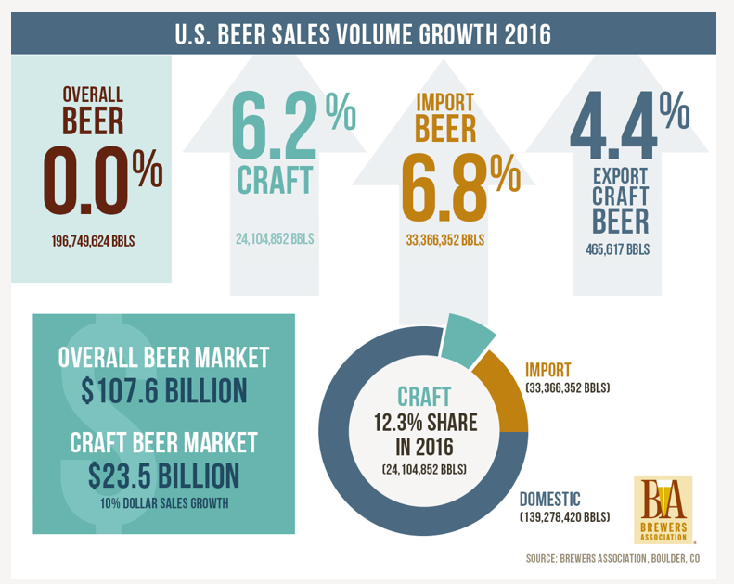
The Craft Beer Industry is Gaining Larger Market Share
While overall beer production is stagnant, craft beer grew 2016
12.3% of volume sold was craft. An increase of 6.2%
21.8% of the dollar sales was craft. An increase of 10%.
The average craft beer six pack sells for $25-$36. Far higher than the typical price for a national brewer’s products.

Slide 7
Craft Beer Industry

Slide 8
What we are looking for
We want to be in the Regional Brewery Space
Still growing, with significant opportunity
Craft Selections that mimic other successful breweries

Slide 9
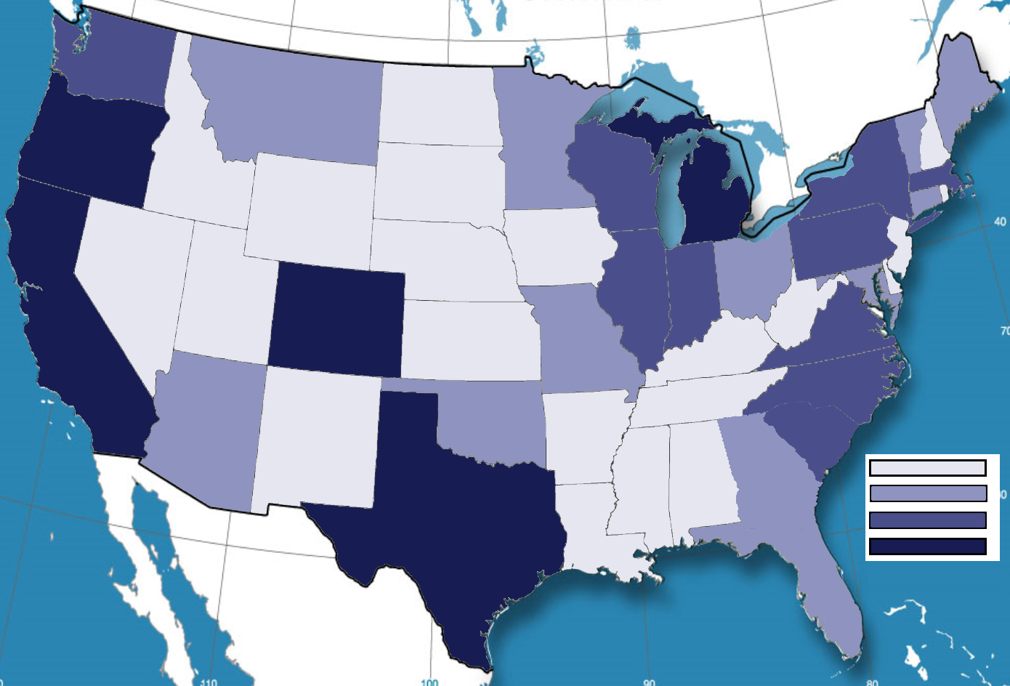
Number of Craft Breweries Per State
1-5
6-15
16-25
26+

Slide 10
2. Merge beer data with the breweries data. Print the first 6 observations and the last six observations to check the merged file.
beersnbrew <- merge(beers, breweries, by.x=c("Brewery_id"), by.y = c("Brew_ID"), all=FALSE)

Slide 11
3. Report the number of NA's in each column.

Slide 12
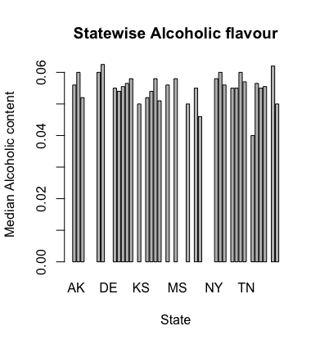
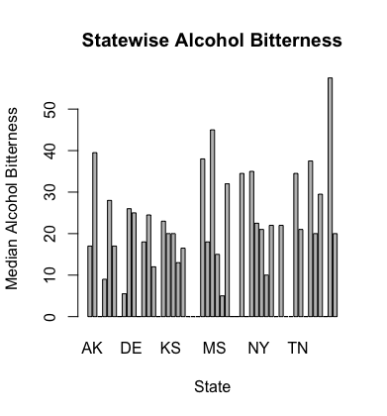
4. Compute the median alcohol content and international bitterness unit for each state. Plot a bar chart to compare.

Slide 13
5. Which state has the maximum alcoholic (ABV) beer? Which state has the most bitter (IBU) beer?
maxABV <- beersnbrew[which.max(beersnbrew$ABV), ]
"State with maximum alcoholic (ABV) beer ” = “CO”
maxIBU <- beersnbrew[which.max(beersnbrew$IBU), ]
"State with the most bitter (IBU) beer ” = “OR”

Slide 14
6. Summary statistics for the ABV variable.

Slide 15
7. Is there an apparent relationship between the bitterness of the beer and its alcoholic content? Draw a scatter plot.
ggplot(beersnbrew, aes(x=IBU, y=ABV)) +geom_point(shape=18, color="blue")+geom_smooth(method=lm, se=FALSE, linetype="dashed",color="darkred")

Slide 16
Conclusion
Colorado has the highest number of breweries among all states followed by California, Michigan.
Portland has the highest number of breweries among all major US cities followed by Chicago, Seattle.
IPA is the most popular beer style in US.

